Slide 1


Team Agile Robotic Control
Logan Beaver
Justin Campbell
Tyler Paddock
Ronald Shipman

Slide 2
Project Overview
Develop initial robotics platform
Public Outreach
Increase interest in STEM fields
Engineering deficit
Fluid Power
Educational robotics platform
Fluid Power
Control Systems
Robotics

Slide 3
Major Design Decisions
Quadruped Locomotion
Agile motion
Stable
Rugged Terrain
Pneumatic Power
High energy density
Clean and lightweight

Slide 4
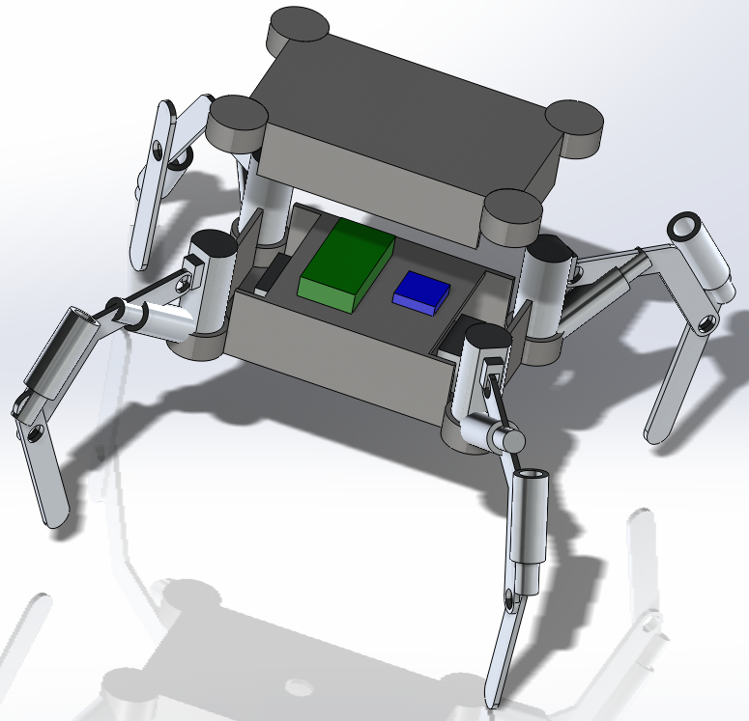
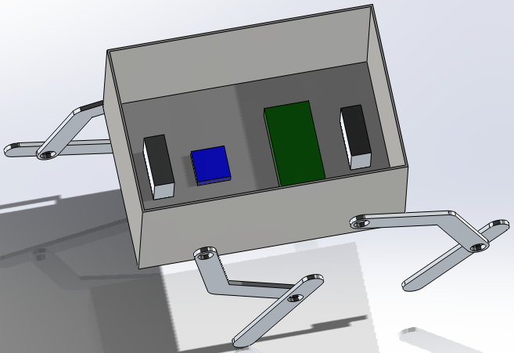
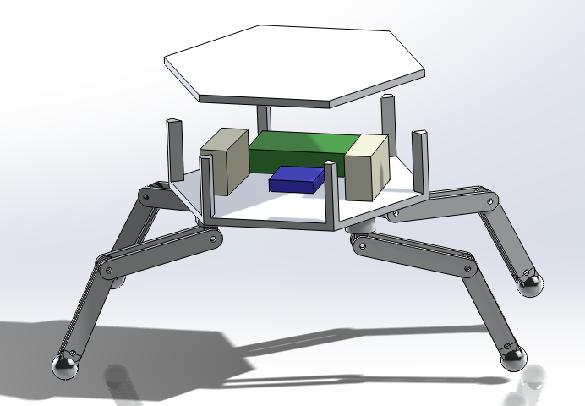
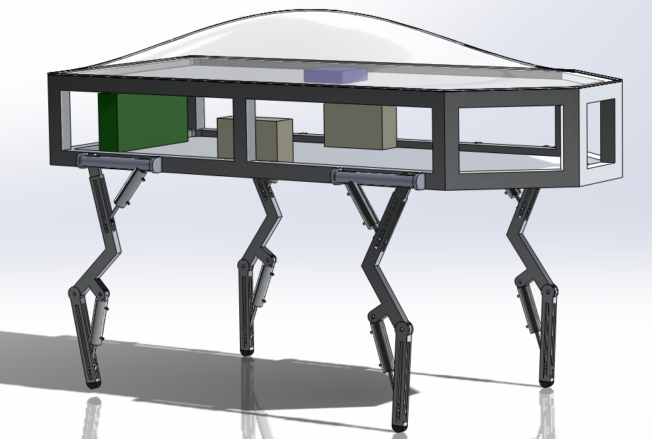
Design Ideas
Hexabot
DogeBot
Arachnea
Boxxy

Slide 5
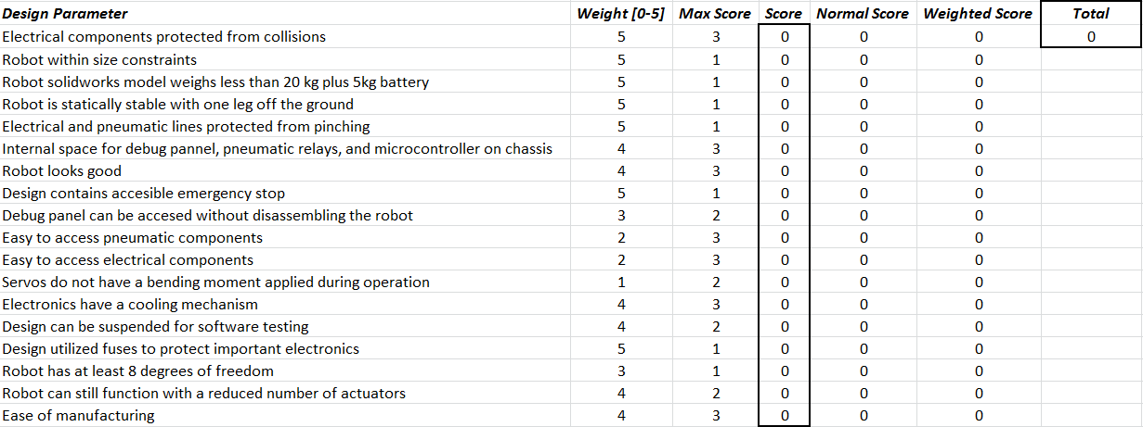
Mechanical Design Matrix

Slide 6
Dogebot
Pros
Legs cannot interfere with each other
Adequate space for components
Open sides for easy accessibility
Cons
Legs may be susceptible to bending
Near the limit on all dimensions and weight

Slide 7
Design Updates
Chassis
Extruded T-Slotted Aluminum Frame
Easy to assemble and attach components
Decreased dimensions to reduce weight
Legs
Fixed piston attachment points
Attached to top of chassis to increase stability

Slide 8
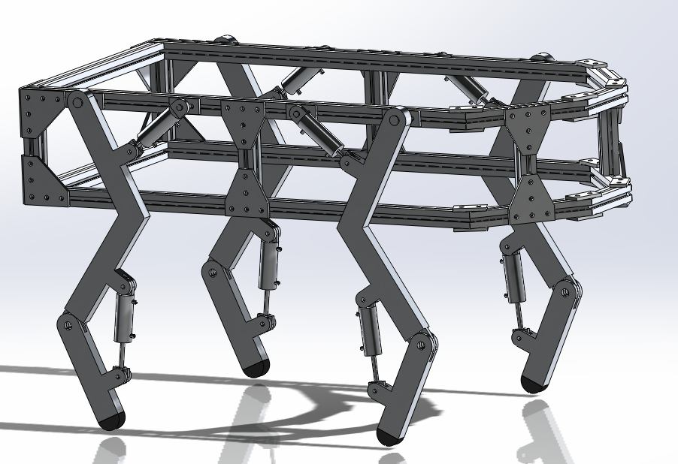
DogeBot 2.0

Slide 9
Power Source Options
 | Advantages | Disadvantages
Hydraulic Power Source | -Highest achievable power density | -High maintenance -Heavy -Dirty
Electric Power Source | -Accurate positioning | -Lowest achievable power density -Noncompliant
Pneumatic Power Source | -Higher power density than electric power -Low Maintenance -Compliant action from fluid compression | -Compressible fluid causes inaccuracy in positioning

Slide 10
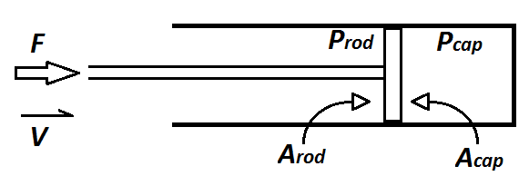
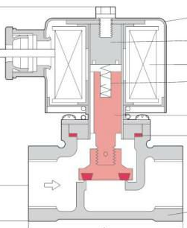
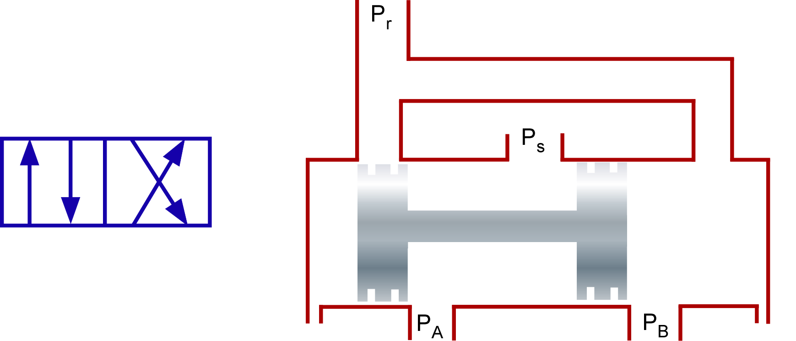

Components
Pneumatic components include:
Receiver Tank
Air Compressor
Double Acting Air Cylinders (w/ feedback)
Solenoid Valve
Directional Control Valves (4/2)
Pressure Relief Valve
Tubing
$$F =P_{cap}A_{cap} −P_{rod}A_{rod}$$

Slide 11
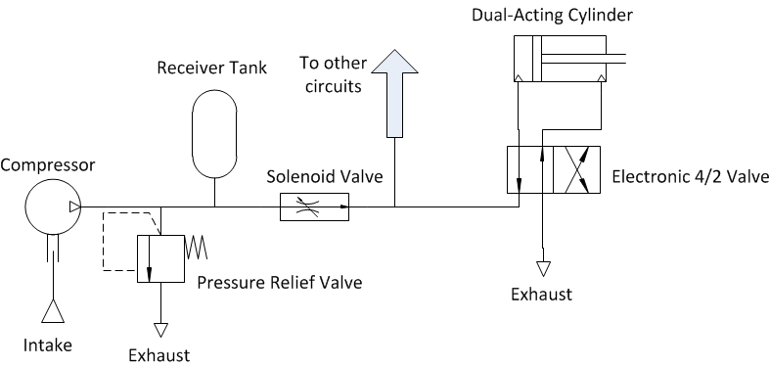
Pneumatic Circuit

Slide 12

Kinematic Model
Homogenous Transformations
Determines cylinder stroke
Shank X Acceleration:
$$\text{LH}\text{4∗}\text{cos}\text{(}\text{tb}\text{)∗}\text{tbdot}\text{^2 − }\text{LK}\text{4∗}\text{cos}\text{(}\text{th}\text{4)∗}\text{th}\text{4}\text{dot}\text{^2 + }\text{xddot}\text{ + }\text{LH}\text{4∗}\text{tbddot}\text{∗}\text{sin}\text{(}\text{tb}\text{) − }\text{LK}\text{4∗}\text{th}\text{4}\text{ddot}\text{∗}\text{sin}\text{(}\text{th}\text{4) − }\text{S}\text{4∗}\text{tk}\text{4}\text{ddot}\text{∗}\text{sin}\text{(}\text{tk}\text{4)}$$

Slide 13

Dynamic Model
$q=\left[\begin{aligned}\text{X} \\ \text{Y} \\ {\text{θ}}_{Body} \\ {\text{θ}}_{Hip 1} \\ {\text{θ}}_{Knee 1} \\ {\text{θ}}_{Hip 2} \\ {\text{θ}}_{Knee 2} \\ {\text{θ}}_{Hip 3} \\ {\text{θ}}_{Knee 3} \\ \begin{aligned}{\text{θ}}_{Hip 4} \\ {\text{θ}}_{Knee 4}\end{aligned}\end{aligned}\right]$
Lagrangian Mechanics
Non-inertial reference frames
Arbitrary global reference frame
Determines mechanical properties of components
27 Equations with state vector q

Slide 14
Control architecture
Control algorithms: Software implemented PIDs
Software: MATLAB/Simulink and associated CODER software
Simulink model of the control is developed and then C code is generated for the target hardware
Current hardware is an Arduino Mega 2560
The feedback in the control loop will be a position feedback from the cylinder

Slide 15
<Picture of Simulink model with PIDs>

Slide 16
Signal Conditioning
PWM signals from the microcontroller are filtered into analog signals to drive the pneumatic actuators
The analog signals will be scaled by amplifiers to the correct voltage required by the pneumatic actuator
Opto-isolators used to protect microcontroller by separating power circuits

Slide 17
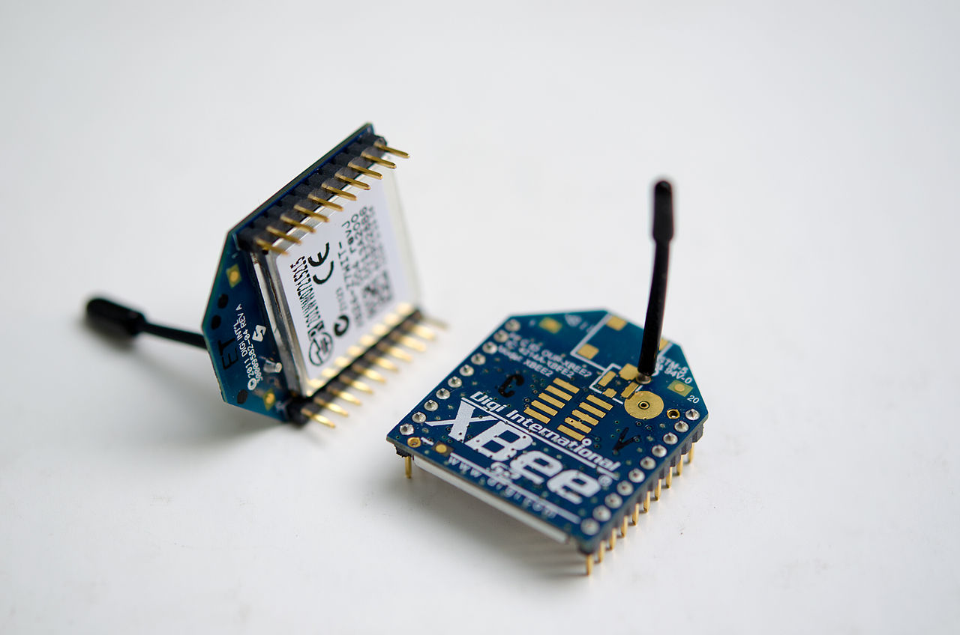
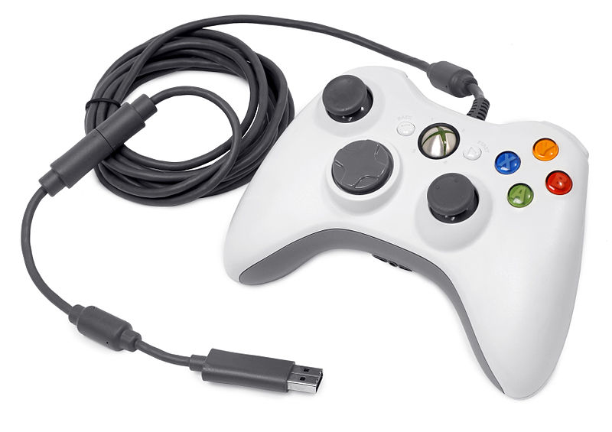
User Interface and Remote COntrol
Xbee short range radio devices using IEEE standard 802.15.4
Range: 100 meters
250Kbps maximum
2.4GHz operating frequency

Slide 18
What’s Next?
Determine necessary output forces of cylinders based on kinematic equations
Select appropriate pneumatic components based on needed specifications
Test air cylinders
Pneumatic circuit construction
Test circuit with control system

Slide 19
Questions?

